Slide 1
clustering

Slide 2
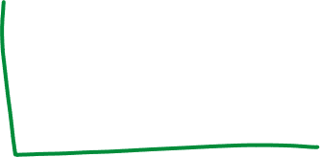
Clustering Algorithms
K-means and its variants
Hierarchical clustering
Density-based clustering

Slide 3
Hierarchical Clustering
Produces a set of nested clusters organized as a hierarchical tree
Can be visualized as a dendrogram
A tree like diagram that records the sequences of merges or splits
Notes:
Den_drunk_gram

Slide 4
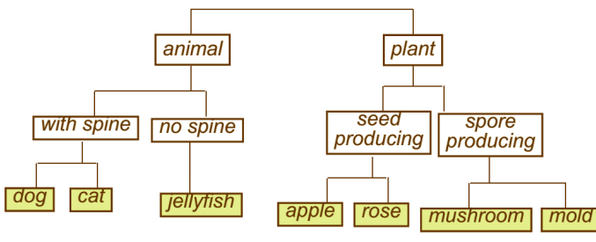
Strengths of Hierarchical Clustering
Do not have to assume any particular number of clusters
Any desired number of clusters can be obtained by ‘cutting’ the dendrogram at the proper level
They may correspond to meaningful taxonomies
Example: biological science
Notes:
all files and folders on the hard disk are organized in hierarchy

Slide 5
Hierarchical Clustering
Two main types of hierarchical clustering
Agglomerative:
Start with the points as individual clusters
At each step, merge the closest pair of clusters until only one cluster (or k clusters) left
Divisive:
Start with one, all-inclusive cluster
At each step, split a cluster until each cluster contains an individual point (or there are k clusters)
Traditional hierarchical algorithms use a similarity or distance matrix
Merge or split one cluster at a time

Slide 6
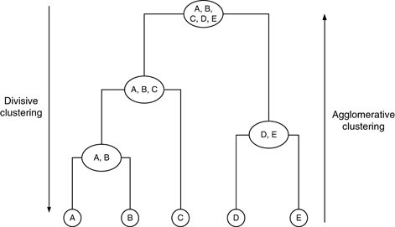
Hierarchical Clustering

Slide 7
How to Define Inter-Cluster Distance
p1
p2
p3
p4
p5
. . .
p1
Similarity?
p2
p3
p4
MIN
MAX
Group Average
Distance Between Centroids
Other methods driven by an objective function
Ward’s Method uses squared error
p5
.
.
.
Proximity Matrix

Slide 8
How to Define Inter-Cluster Similarity
p1
p2
p3
p4
p5
. . .
p1
p2
p3
p4
MIN
MAX
Group Average
Distance Between Centroids
Other methods driven by an objective function
Ward’s Method uses squared error
p5
.
.
.
Proximity Matrix

Slide 9
How to Define Inter-Cluster Similarity
p1
p2
p3
p4
p5
. . .
p1
p2
p3
p4
MIN
MAX
Group Average
Distance Between Centroids
Other methods driven by an objective function
Ward’s Method uses squared error
p5
.
.
.
Proximity Matrix

Slide 10
How to Define Inter-Cluster Similarity
p1
p2
p3
p4
p5
. . .
p1
p2
p3
p4
MIN
MAX
Group Average
Distance Between Centroids
Other methods driven by an objective function
Ward’s Method uses squared error
p5
.
.
.
Proximity Matrix

Slide 11
How to Define Inter-Cluster Similarity
p1
p2
p3
p4
p5
. . .
p1
×
×
p2
p3
p4
MIN
MAX
Group Average
Distance Between Centroids ( centroid: average of all points in that cluster)
Other methods driven by an objective function
Ward’s Method uses squared error
p5
.
.
.
Proximity Matrix

Slide 12
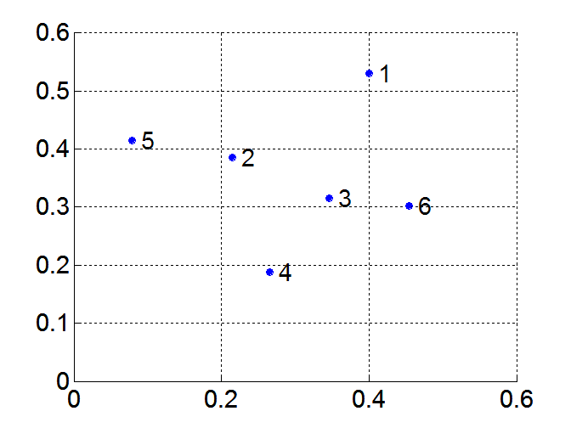
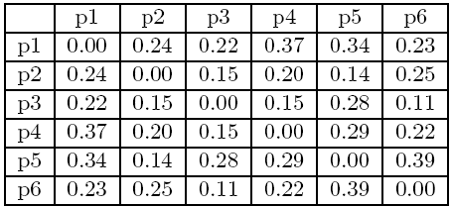

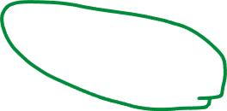
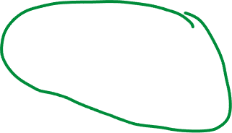



MIN or Single Link
Proximity of two clusters is based on the two closest points in the different clusters
Determined by one pair of points, i.e., by one link in the proximity graph
Example:
Distance Matrix:

Slide 13



Hierarchical Clustering: MIN
5
1
3
5
2
1
2
3
6
4
4
Nested Clusters
Dendrogram

Slide 14
Pros and cons
 | Min | Max | Group Average
Strength | Can handle non-elliptical shapes | Less susceptible to noise | Less susceptible to noise
Weakness | Sensitive to noise | Tends to break large clusters | Biased towards globular clusters
 |  | Biased towards globular clusters

Slide 15
Hierarchical Clustering: Comparison
5
4
1
1
3
2
5
5
5
2
2
1
MAX
MIN
3
2
3
6
3
6
1
4
4
4
5
5
4
1
1
2
2
Ward’s Method
5
5
2
2
Group Average
3
6
3
6
1
3
1
4
4
4
3

Slide 16



Hierarchical Clustering: Time and Space requirements
O(N²) space since it uses the proximity matrix.
N is the number of points.
O(N³) time in many cases:
There are N steps and at each step the size, N², proximity matrix must be updated and searched
Complexity can be reduced to O(N² log(N) ) time with some cleverness
Distance Matrix:

Slide 17
Hierarchical Clustering: Problems and Limitations
Once a decision is made to combine two clusters, it cannot be undone
No global objective function is directly minimized
Different schemes have problems with one or more of the following:
Sensitivity to noise
Difficulty handling clusters of different sizes and non-globular shapes
Breaking large clusters

Slide 18
Clustering Algorithms
K-means and its variants
Hierarchical clustering
Density-based clustering

Slide 19
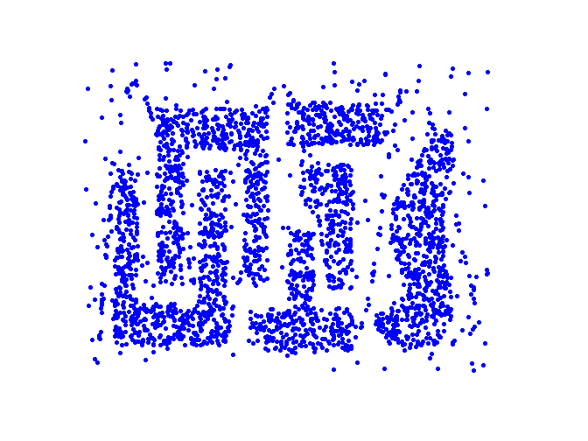


Density Based Clustering
Clusters are regions of high density that are separated from one another by regions on low density.

Slide 20
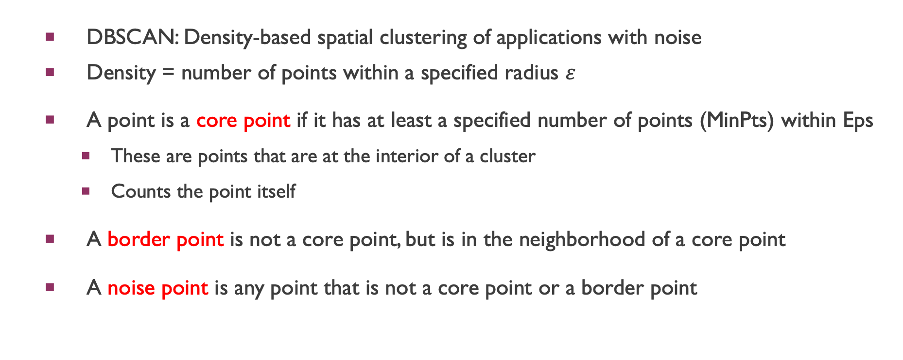

density-based algorithm: DBSCAN
DBSCAN: Density-based spatial clustering of applications with noise
Density = number of points within a specified radius $ε$
A point is a core point if it has at least a specified number of points (MinPts) within Eps
These are points that are at the interior of a cluster
Counts the point itself
A border point is not a core point, but is in the neighborhood of a core point
A noise point is any point that is not a core point or a border point

Slide 21
DBSCAN: Core, Border, and Noise Points
MinPts = 7

Slide 22
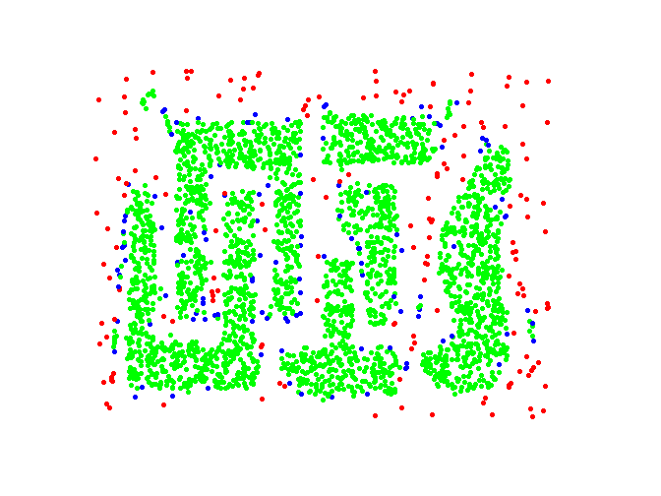
DBSCAN: Core, Border and Noise Points
Original Points
Point types: core, border and noise
Eps = 10, MinPts = 4

Slide 23
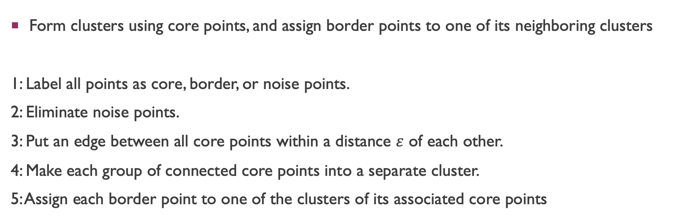
DBSCAN Algorithm
Form clusters using core points, and assign border points to one of its neighboring clusters
1: Label all points as core, border, or noise points.
2: Eliminate noise points.
3: Put an edge between all core points within a distance $ε$ of each other.
4: Make each group of connected core points into a separate cluster.
5: Assign each border point to one of the clusters of its associated core points

Slide 24
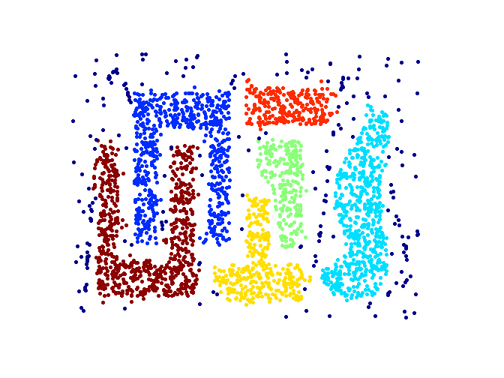
When DBSCAN Works Well
Original Points
Clusters (dark blue points indicate noise)
Can handle clusters of different shapes and sizes
Resistant to noise

Slide 25
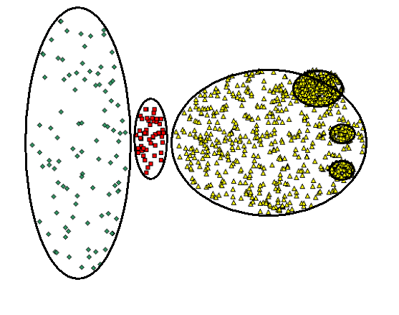
When DBSCAN Does NOT Work Well
Original Points

Slide 26
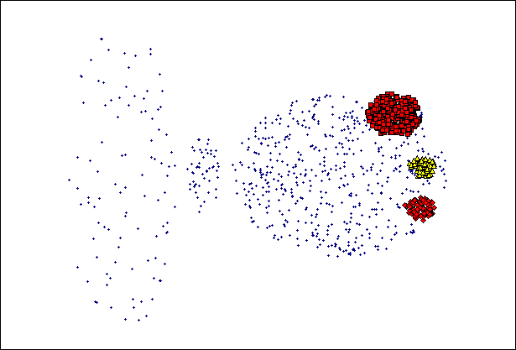
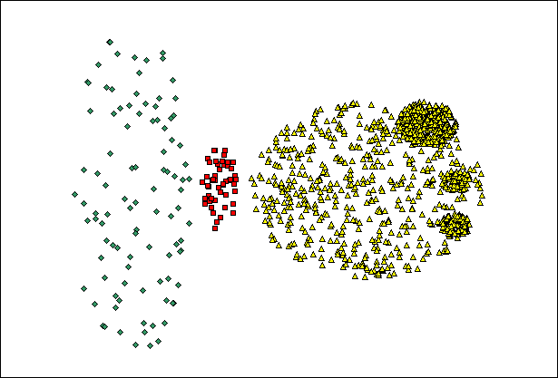
When DBSCAN Does NOT Work Well
(MinPts=4, Eps=9.92).
Original Points
Varying densities
High-dimensional data
(MinPts=4, Eps=9.75)

Slide 27
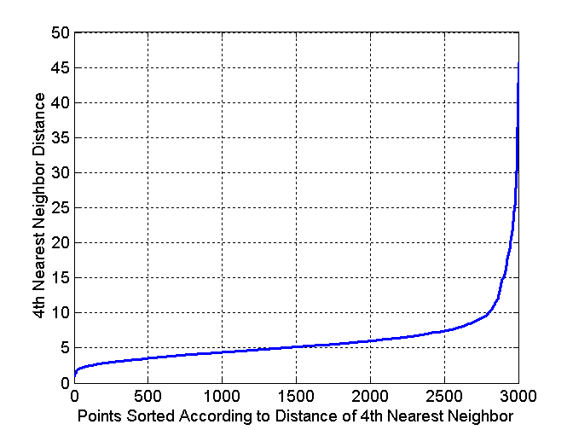
DBSCAN: Determining $ε$ and MinPts
Idea is that for points in a cluster, their k^{th} nearest neighbors are at close distance
Noise points have the k^{th} nearest neighbor at farther distance
So, plot sorted distance of every point to its k^{th} nearest neighbor
Would the graph be from the distance matrix?
Distance matrix – hierachiracal clustering
( proximity matrix)
The graph: density-based clustering

Slide 28
Cluster Validity
For supervised classification we have a variety of measures to evaluate how good our model is
Accuracy, precision, recall ( confusing matrix)
For cluster analysis, the analogous question is how to evaluate the “goodness” of the resulting clusters?
But “clusters are in the eye of the beholder”!
In practice the clusters we find are defined by the clustering algorithm
Then why do we want to evaluate them?
To avoid finding patterns in noise
To compare clustering algorithms
To compare two sets of clusters
To compare two clusters

Slide 29

Clusters found in Random Data
Random Points
DBSCAN
(density-based)
K-means
Complete Link

Slide 30

Measures of Cluster Validity
Numerical measures that are applied to judge various aspects of cluster validity, are classified into the following two types.
Supervised: Used to measure the extent to which cluster labels match externally supplied class labels.
Entropy
Often called external indices because they use information external to the data
Unsupervised: Used to measure the goodness of a clustering structure without respect to external information.
Sum of Squared Error (SSE)
Often called internal indices because they only use information in the data
You can use supervised or unsupervised measures to compare clusters or clusterings

Slide 31
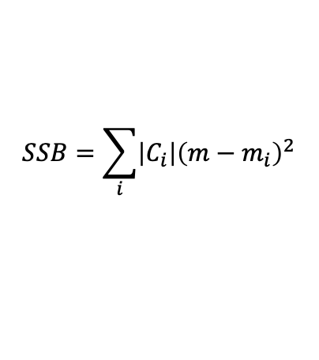

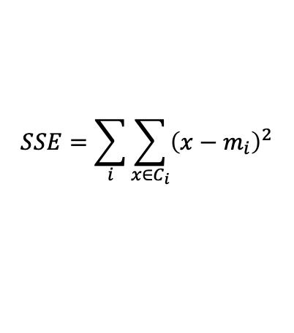
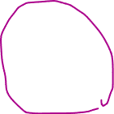
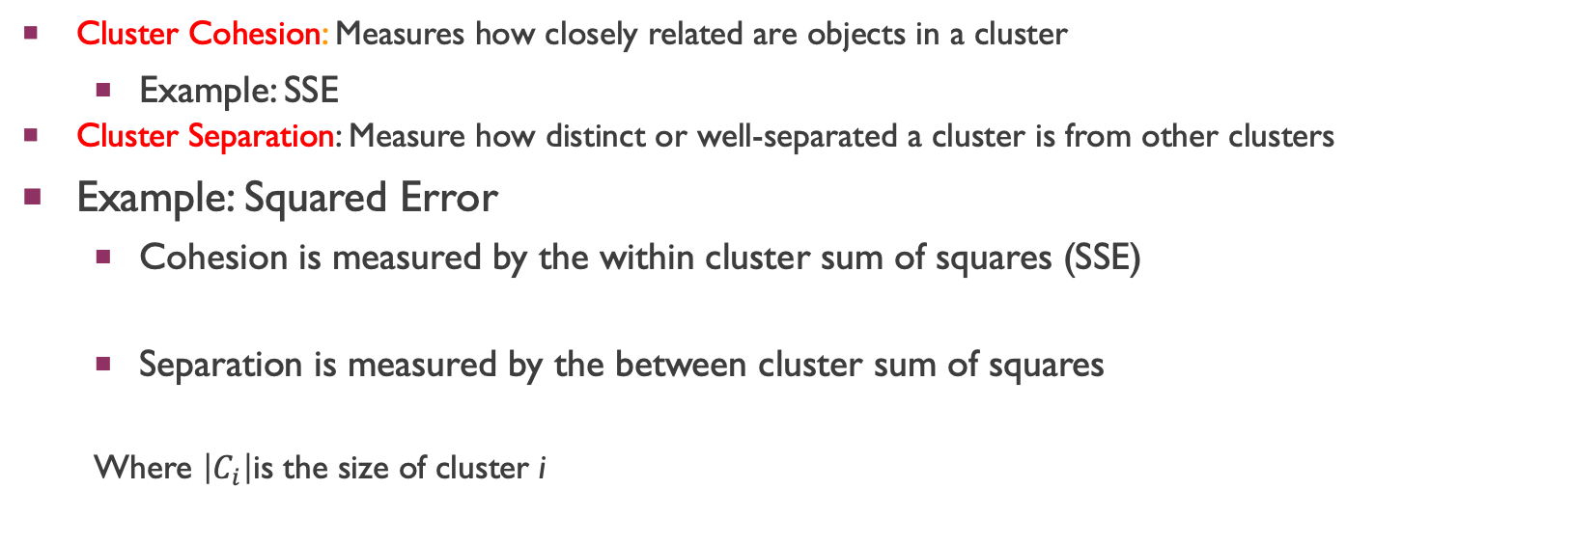
Unsupervised Measures: Cohesion and Separation
Cluster Cohesion: Measures how closely related are objects in a cluster
Example: SSE
Cluster Separation: Measure how distinct or well-separated a cluster is from other clusters
Example: Squared Error
Cohesion is measured by the within cluster sum of squares (SSE)
Separation is measured by the between cluster sum of squares
Where $\left|C_{i}\right|$is the size of cluster i
$$SSE=\sum_{i}{\sum_{x∈C_{i}}{{\left(x−m_{i}\right)}^{2}}}$$
$$SSB=\sum_{i}{\left|C_{i}\right|{\left(m−m_{i}\right)}^{2}}$$

Slide 32





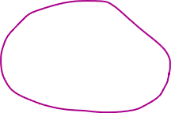

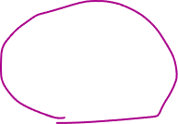
Unsupervised Measures: Cohesion and Separation
Example: SSE
SSB + SSE = constant
m
×
×
×
1
m₁
2
3
4
m₂
5
K=1 cluster:
$$SSE={\left(1−3\right)}^{2}+{\left(2−3\right)}^{2}+{\left(4−3\right)}^{2}+{\left(5−3\right)}^{2}=10$$
$$SSB=4×{\left(3−3\right)}^{2}=0$$
$$Total=10+0=10$$
K=2 clusters:
$$SSE={\left(1−1.5\right)}^{2}+{\left(2−1.5\right)}^{2}+{\left(4−4.5\right)}^{2}+{\left(5−4.5\right)}^{2}=1$$
$$SSB=2 ×{\left(3−1.5\right)}^{2}+2×{\left(4.5−3\right)}^{2}=9$$
$$Total=1+9=10$$

Slide 33
Unsupervised Measures: Cohesion and Separation
A proximity graph-based approach can also be used for cohesion and separation.
Cluster cohesion is the sum of the weight of all links within a cluster.
Cluster separation is the sum of the weights between nodes in the cluster and nodes outside the cluster.
cohesion
separation

Slide 34


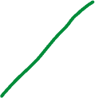
Unsupervised Measures: Silhouette Coefficient
Silhouette coefficient combines ideas of both cohesion and separation, but for individual points, as well as clusters and clusterings
For an individual point, i
Calculate a = average distance of i to the points in its cluster
Calculate b = min (average distance of i to points in another cluster)
The silhouette coefficient for a point is then given by s = (b – a) / max(a,b)
Value can vary between -1 and 1
Typically ranges between 0 and 1.
The closer to 1 the better.
Can calculate the average silhouette coefficient for a cluster or a clustering

